Slide 1

ManitobaWildFire Prediction
Good guys
MENTOR : Qiang Zhang
LEADER: Luwei Lin
MEMBER: Haozhi Wang, Luxiang Lin

Slide 2

WILD-FIRE PERDICT
Before
PROGRESS
AFTER.

Slide 3
Before.
Wildfire news:
Various data
Predication?

Slide 4
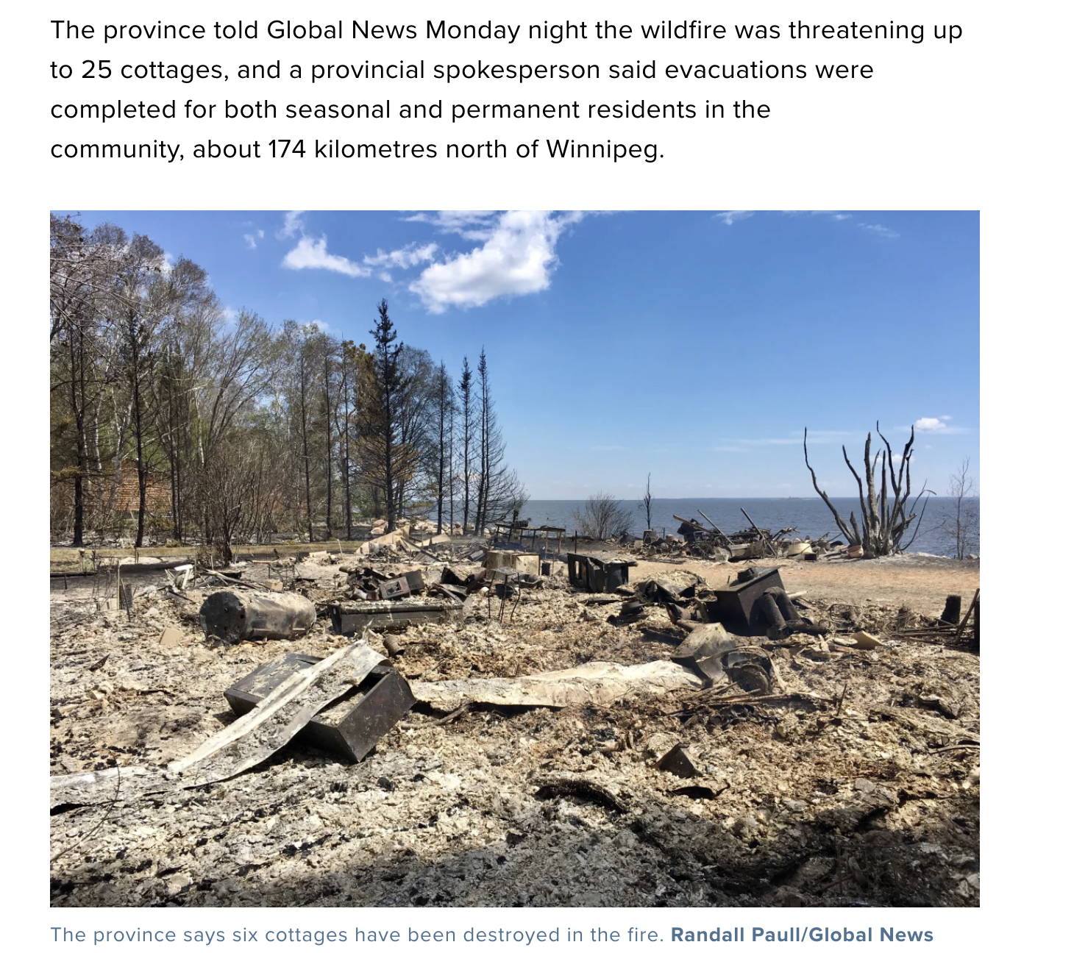
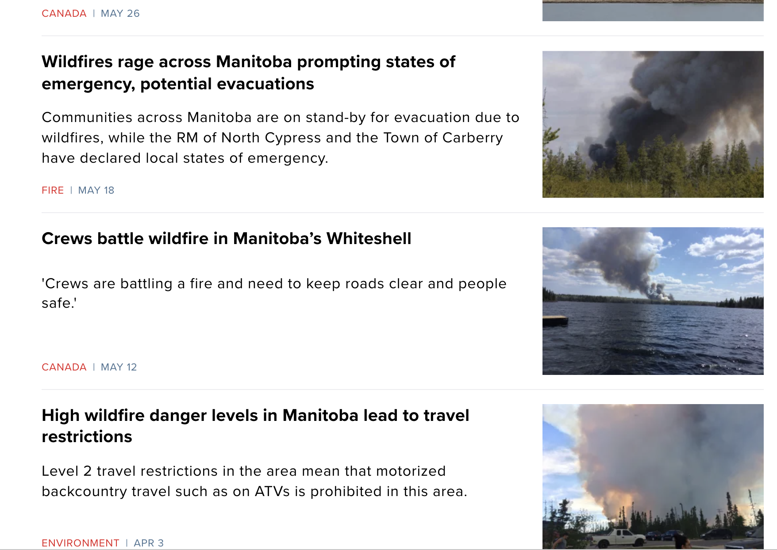
https://globalnews.ca/news/7014687/cottages-evacuated-manitoba-wildfire-beaver-creek/

Slide 5

What we can predicate?

Slide 6

Data
Data aggregation from different sources
v Data crawling

Slide 7
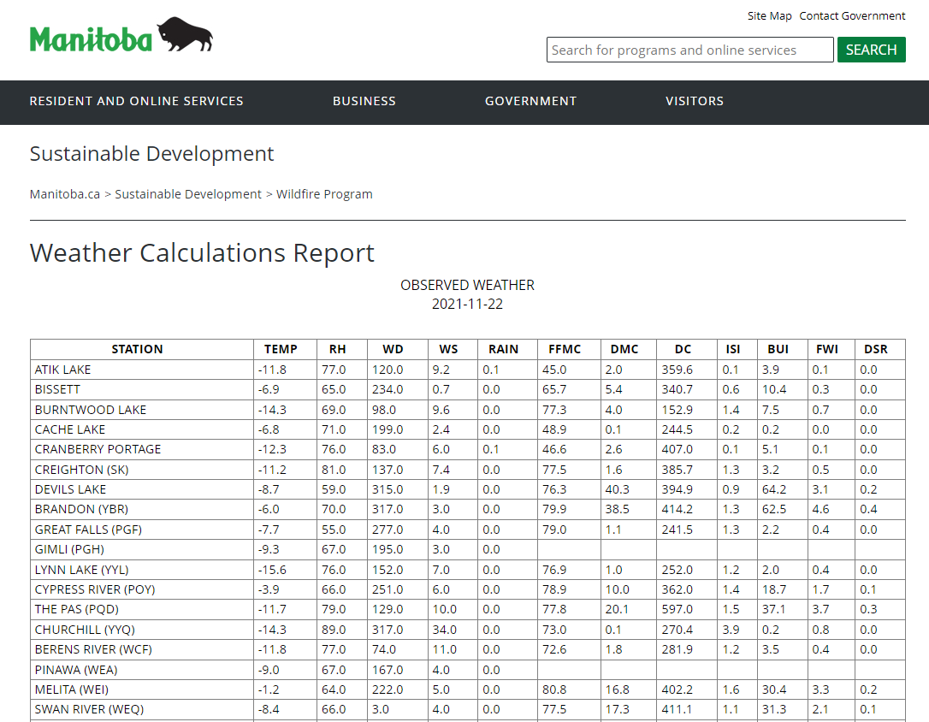
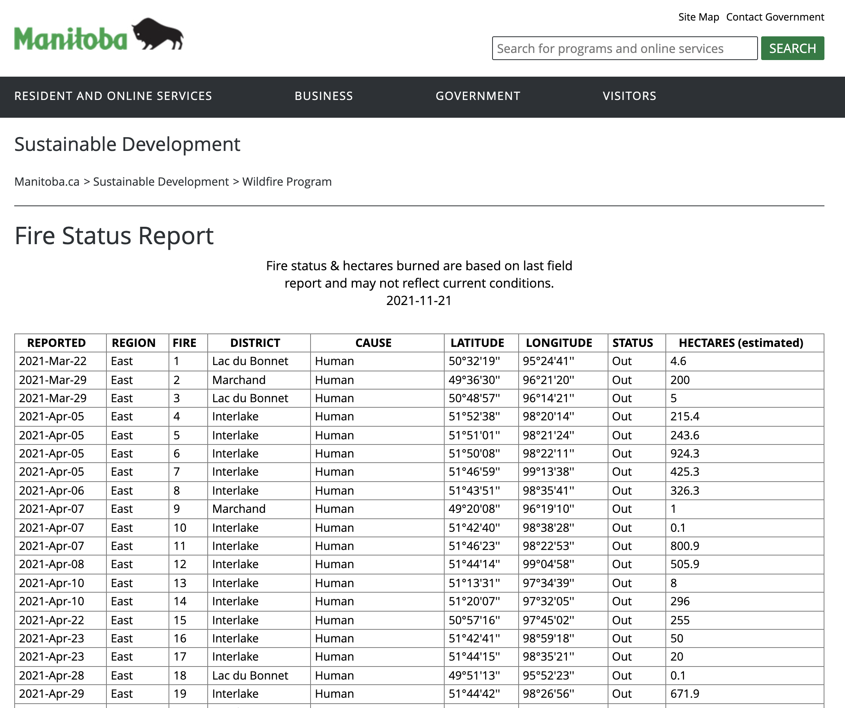

Slide 8
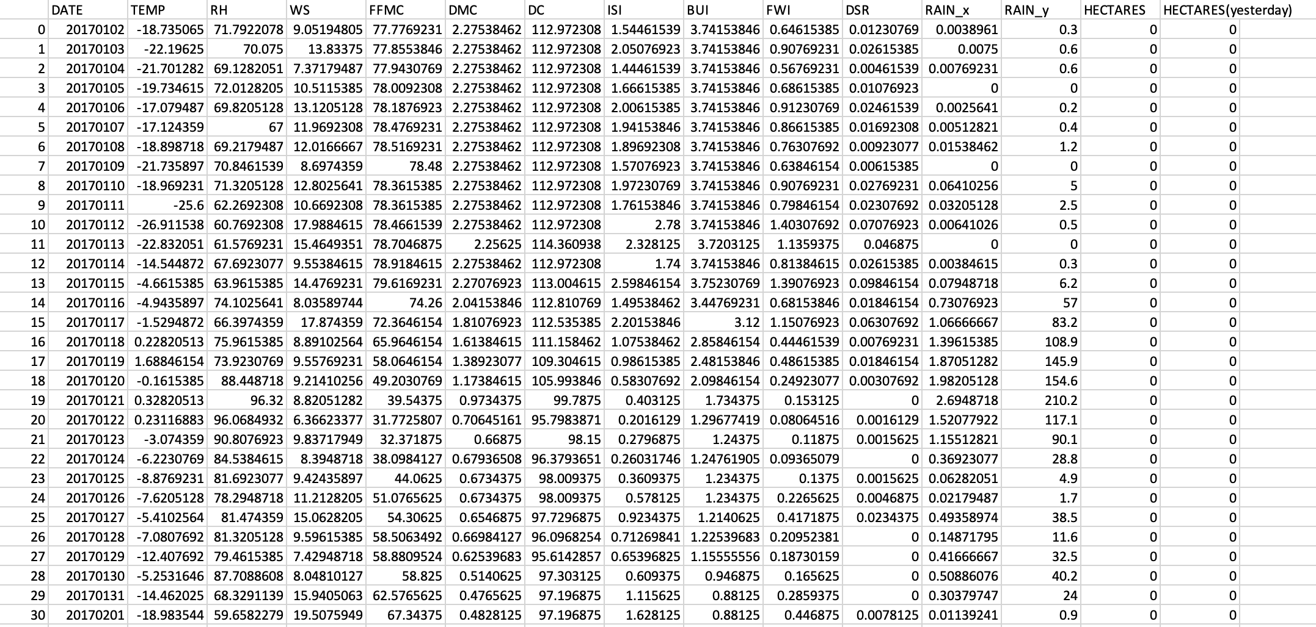

Slide 9
In
Model problems in mathematical ways
How formulate the predication
Choose the right model.
How to evaluate model performance

Slide 10

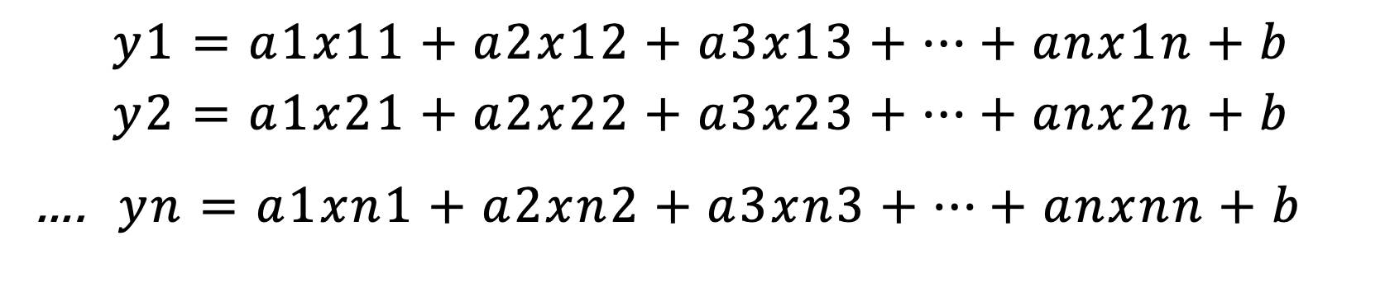
Modeling
$$f\left(temp, relativehumidity, windspeed,rain…\right)=predict burned_area$$
$$Y=AX+B$$
$$y1=a1x11+a2x12+a3x13+…+anx1n+b$$
$$y2=a1x21+a2x22+a3x23+…+anx2n+b$$
…. $yn=a1xn1+a2xn2+a3xn3+…+anxnn+b$
Let machine find the appropriate A[a1, a2, a3, a4, a5… an] coefficients

Slide 11

Evaluation of Output

Slide 12
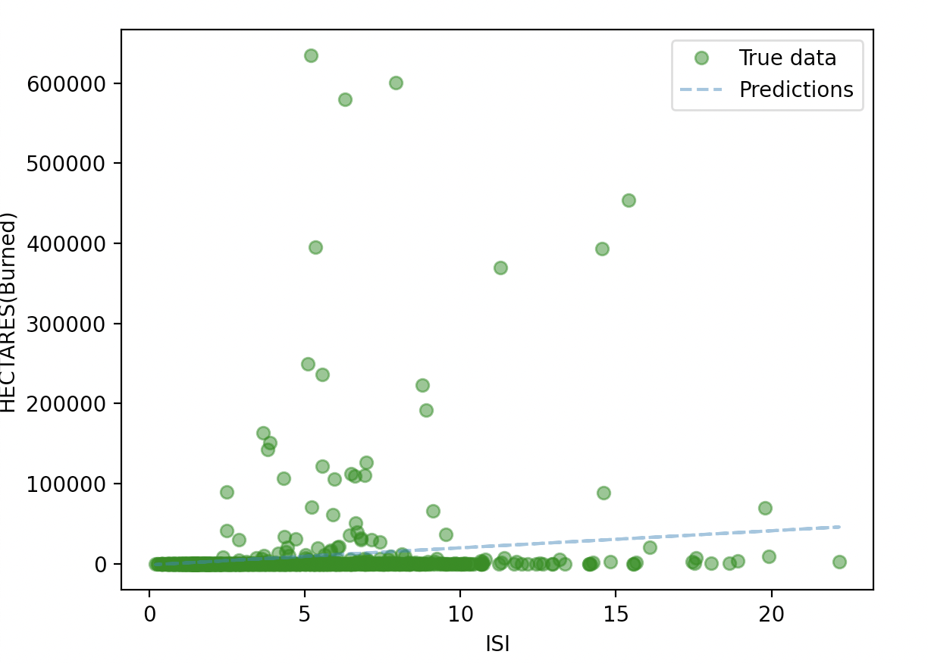
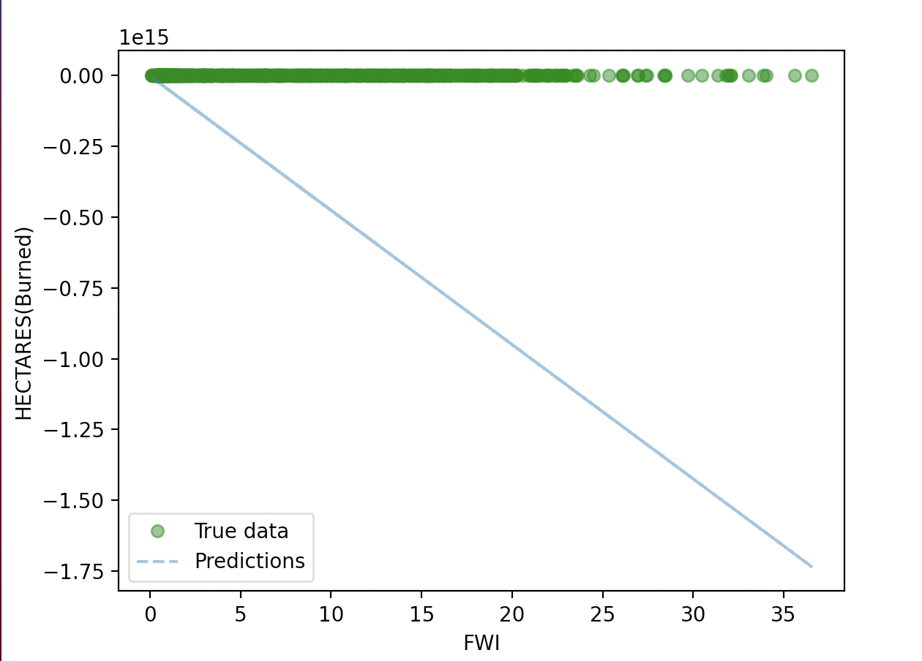
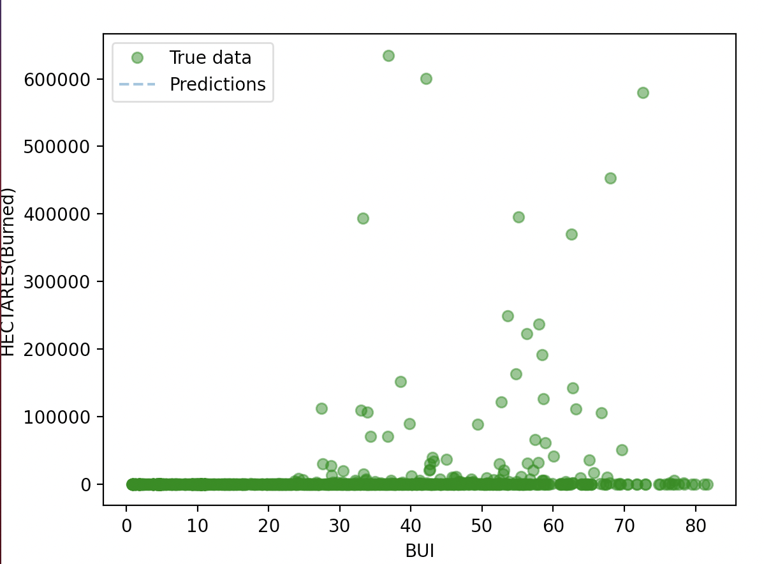
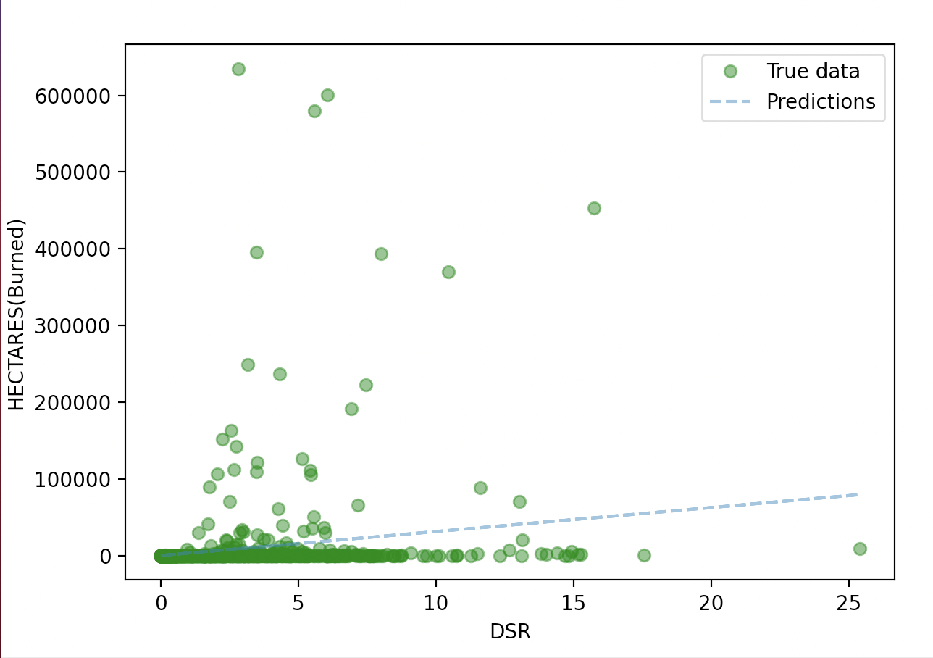
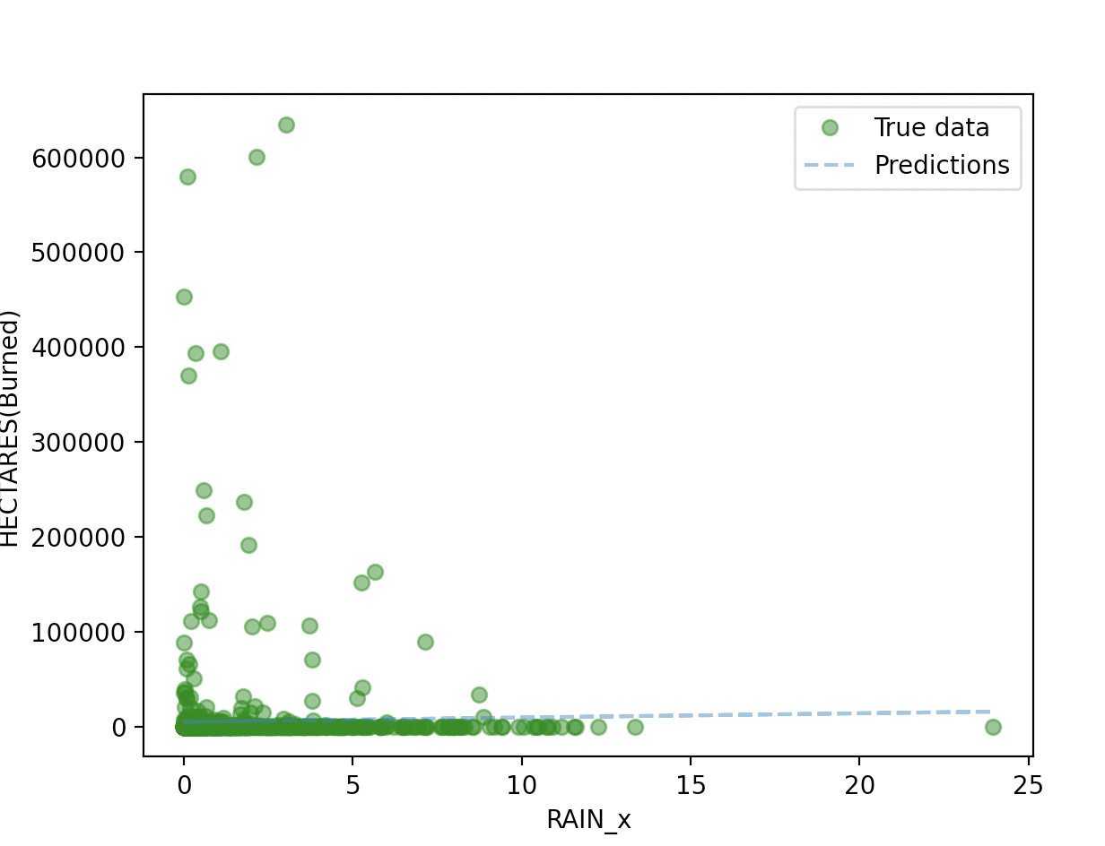
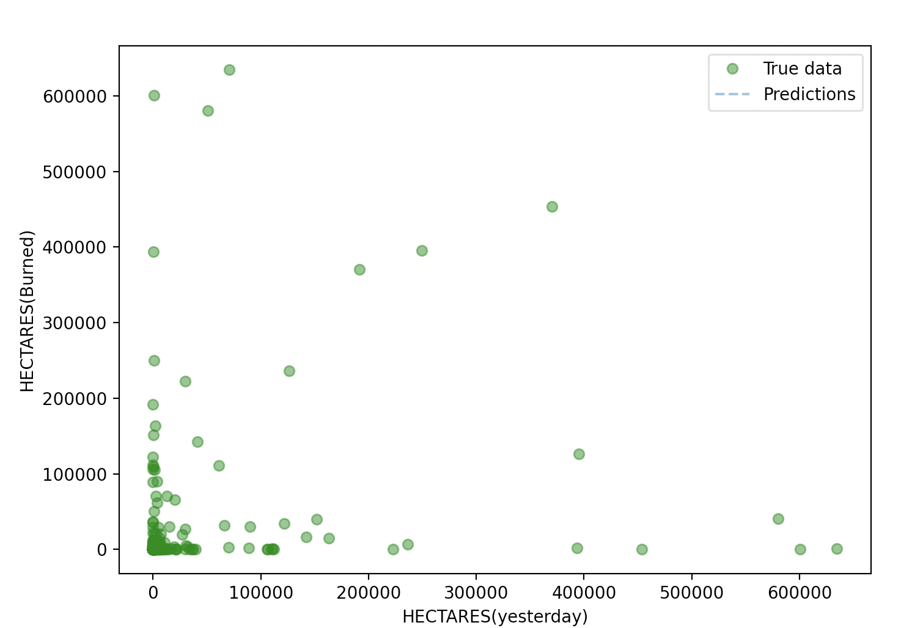

Slide 13
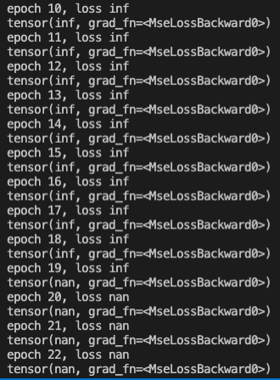
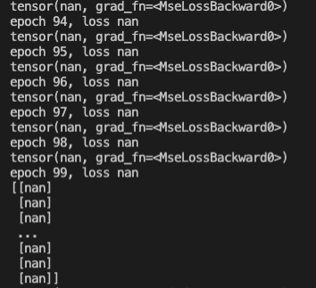
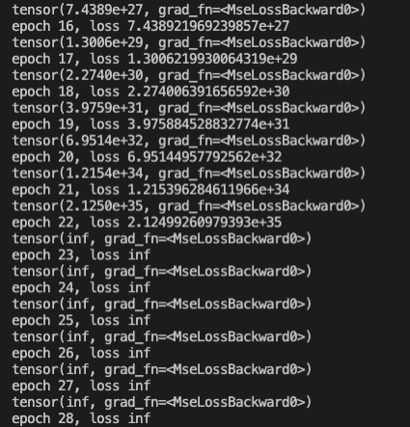

Slide 14
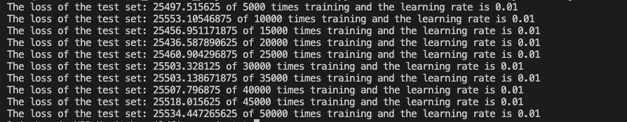
Models
Linear regression
LSTM (still in progress)

Slide 15
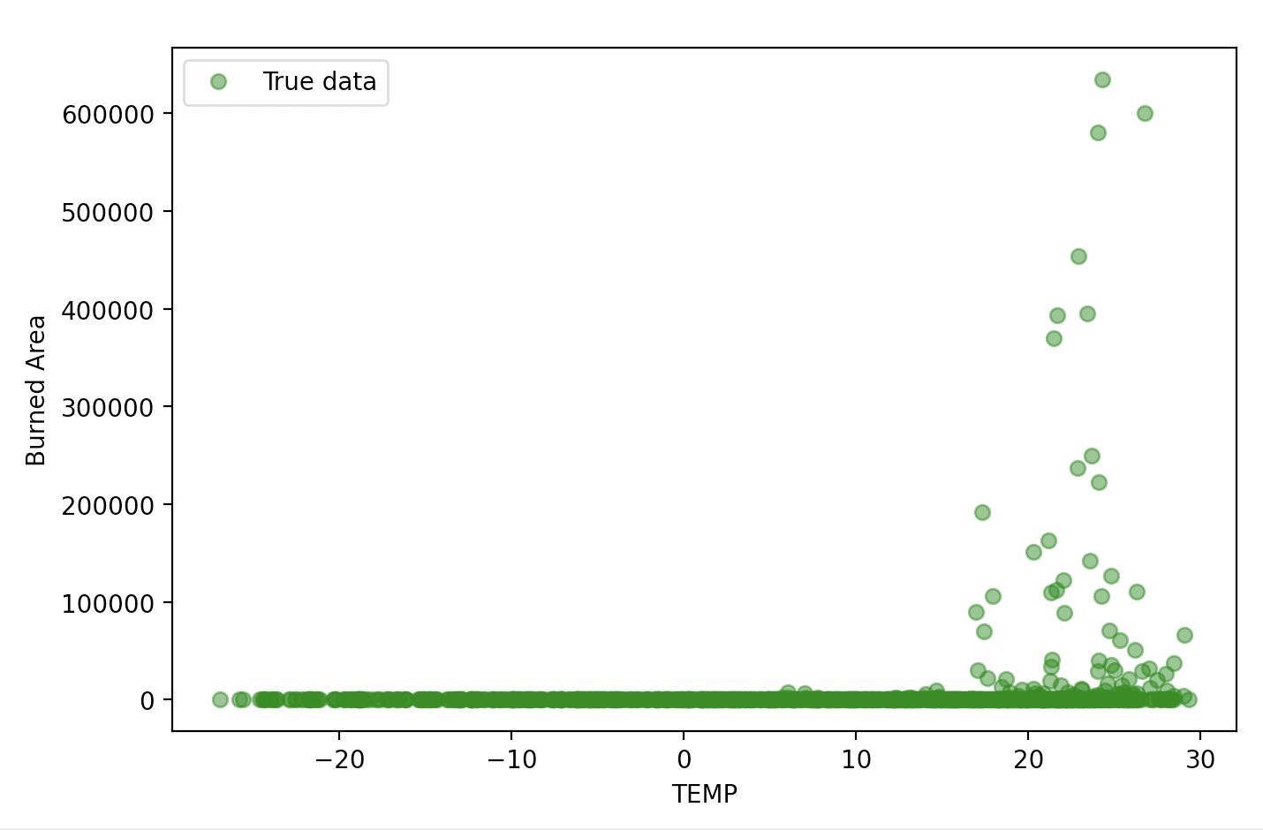
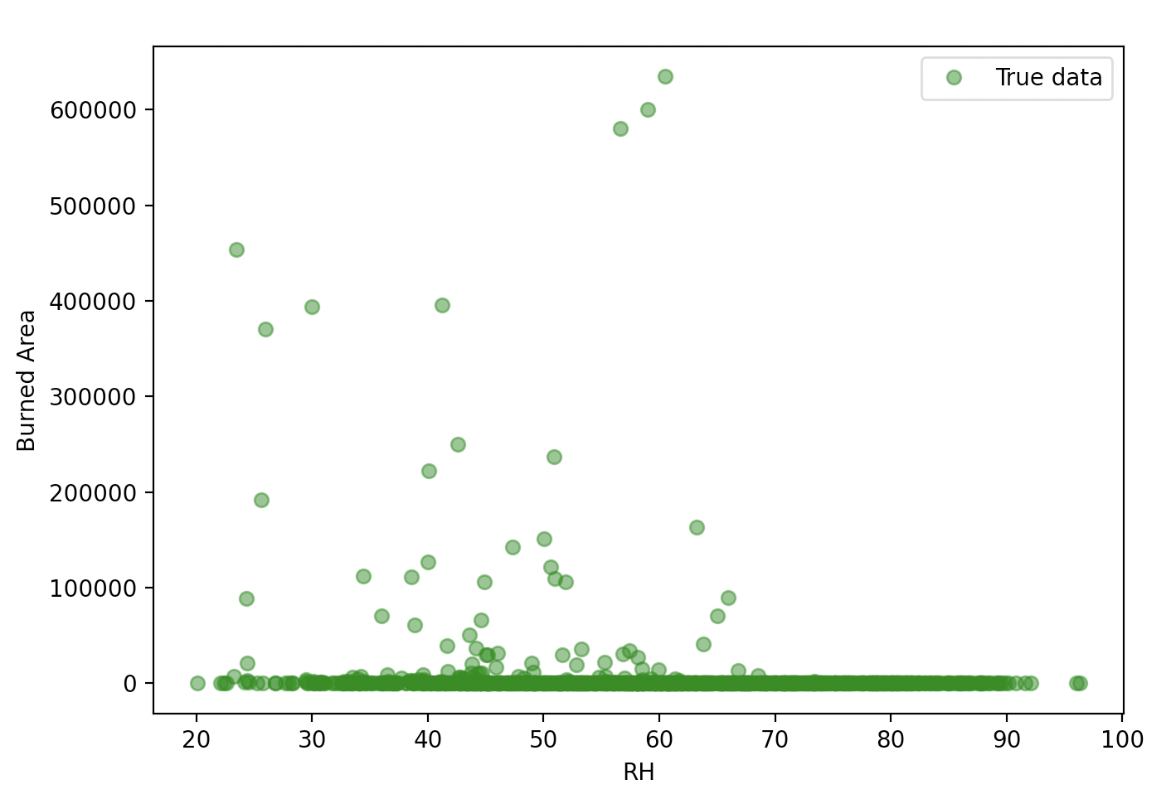
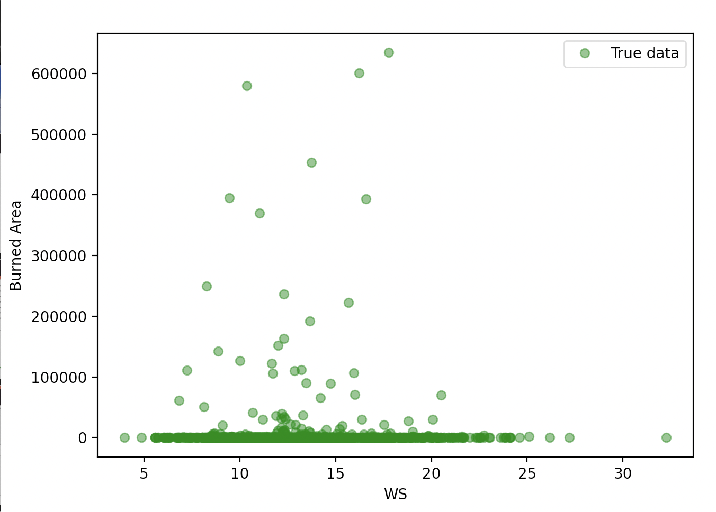
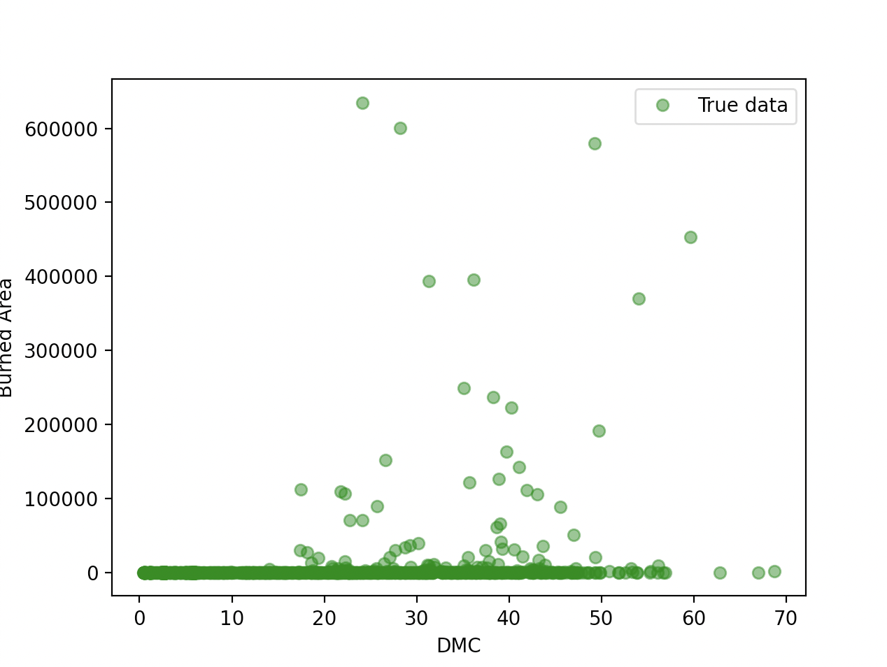
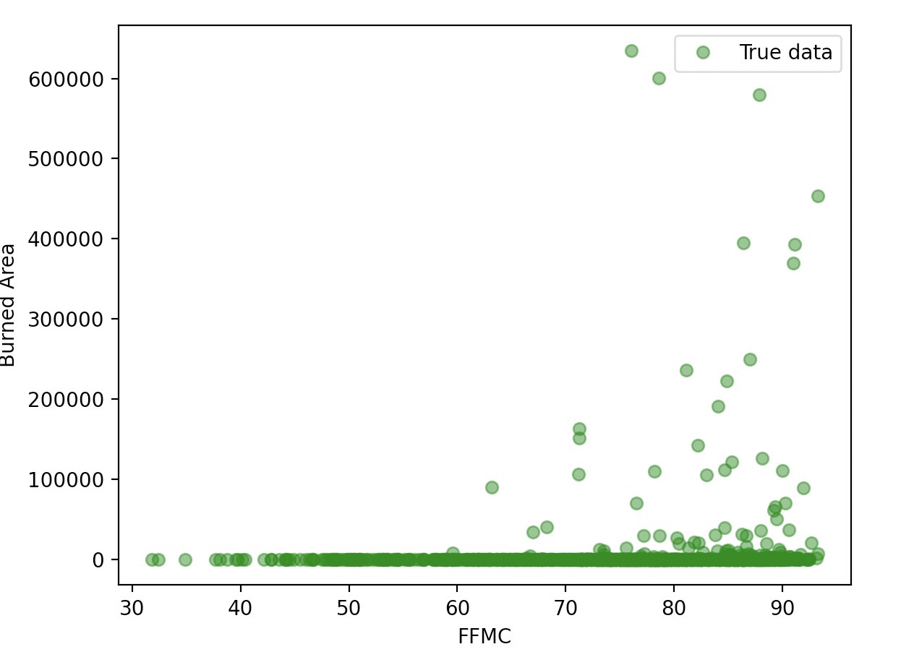
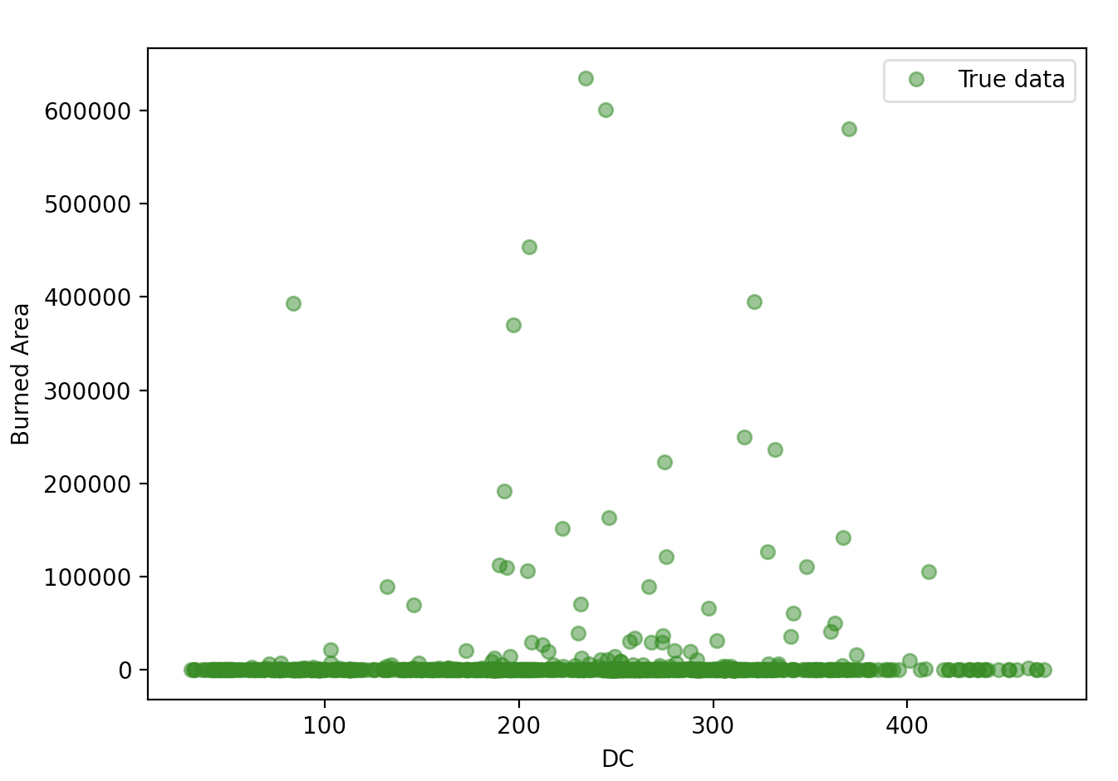

Slide 16
What we learned
1. Data is important
2. Libraries are import
Proper model is important
“Stand on the giant”(Research existing models and examples)
Teamwork!

Slide 17

What We Learned
How to communicate efficiently with mentor, assigning tasks to team members
New insights into machine learning through this project
Notes:
Data collection take significant amount of time
Better at Seeking help from libraries to when facing technical problem

Slide 18
Summary
mentor

Slide 19
Thank you

